Slide 1
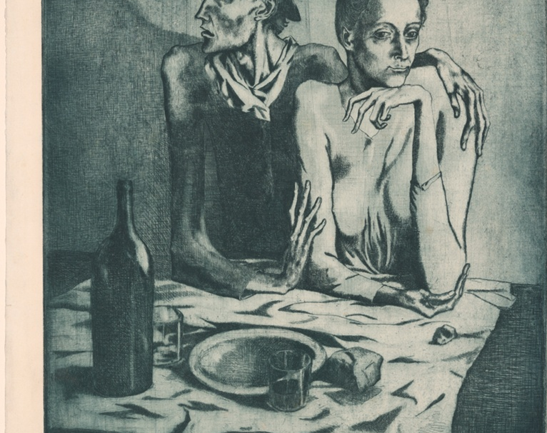
Angular Mini Project
Art Institute of Chicago Artwork Explorer

Slide 2

Features of my Web App :
Home Page: With a hovering Chicago art institute images and a welcome message..
Search Functionality: Search based on the title of the art.
Artwork Listing: Displaying search results in a visually appealing Cards format.
Artwork Details: Enabling learners to click on an artwork to view detailed information and a larger image.
Pagination: Implemented pagination for large result sets to ensure a smooth user experience.
User Favorites: Allowing learners to mark artworks as favorites and save them for future reference
Sharing Feature: Added a feature to share artworks on social media.
Responsive Design: Application is Responsive and looks good on both desktop and mobile
Error Handling: Handled API request errors gracefully and provide informative error messages to the user.

Slide 3
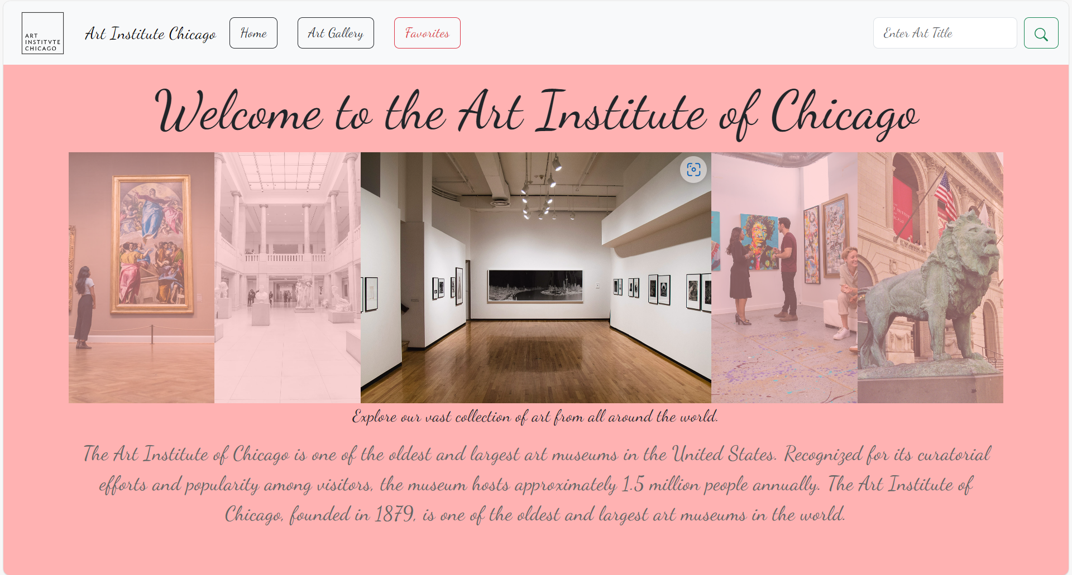
Home

Slide 4
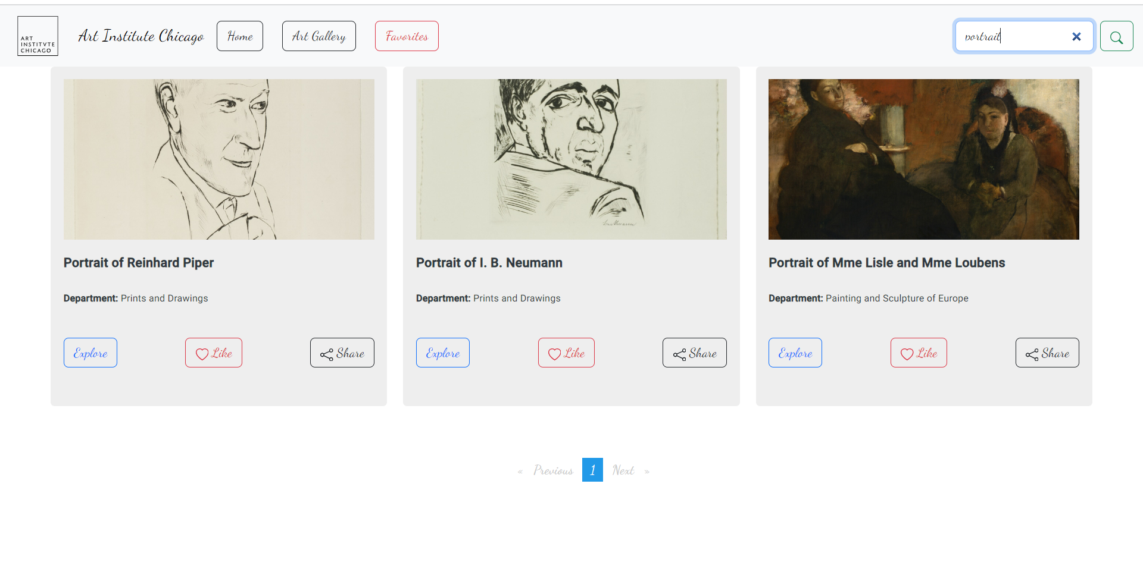
Search Functionality:

Slide 5
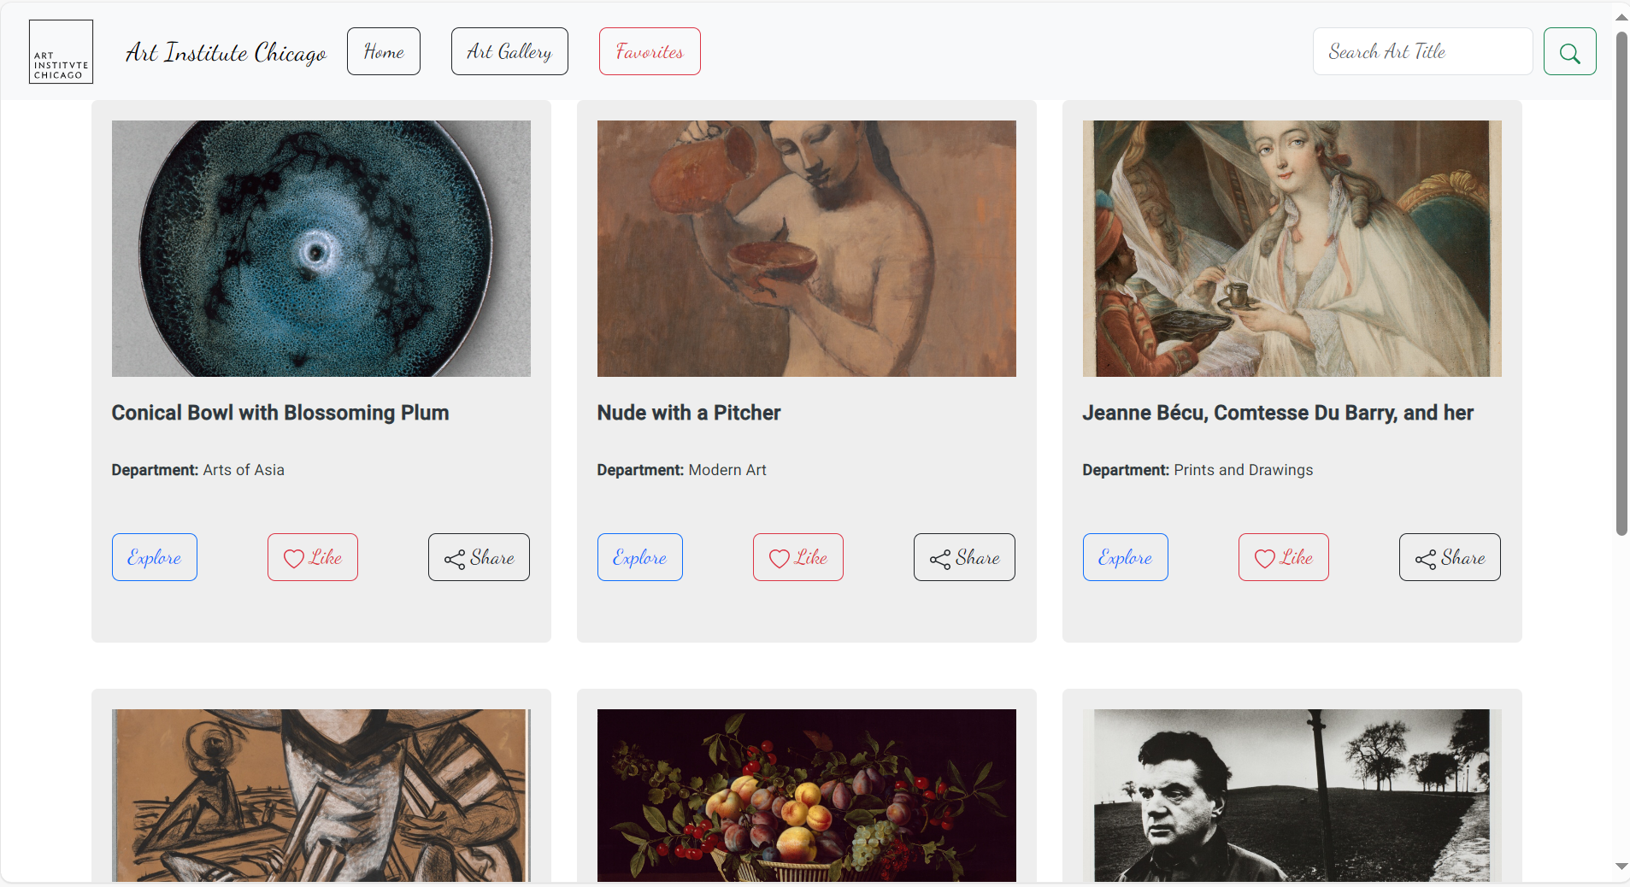
Art Work Listing:

Slide 6
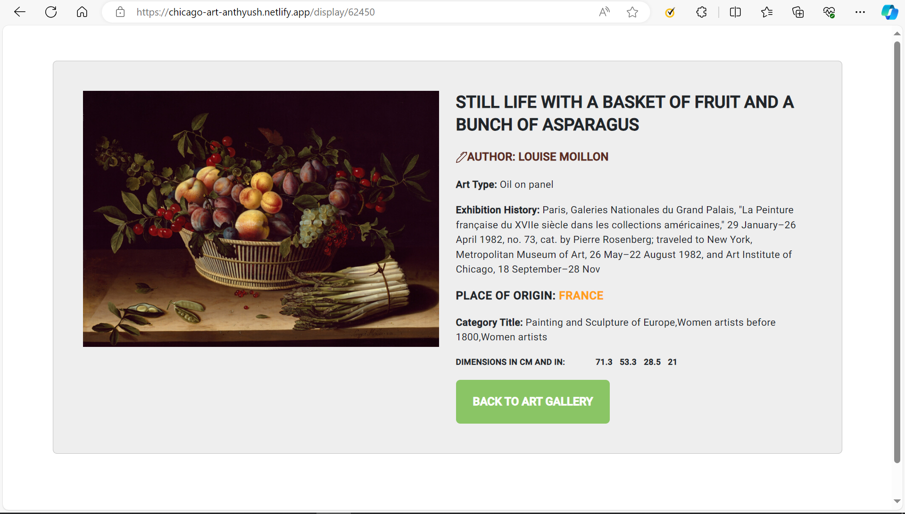
Explore Page:

Slide 7
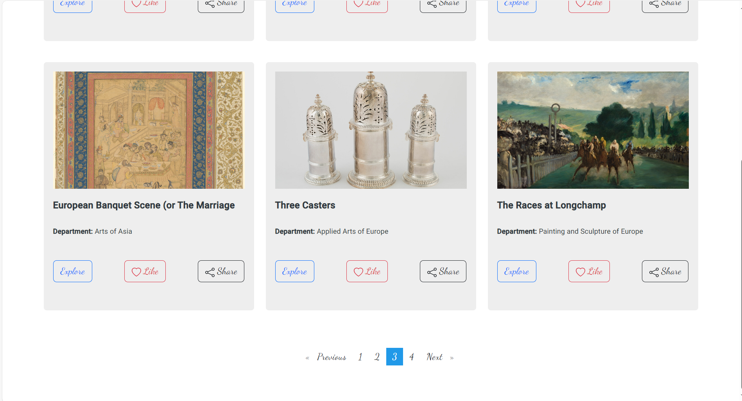
Pagination:

Slide 8
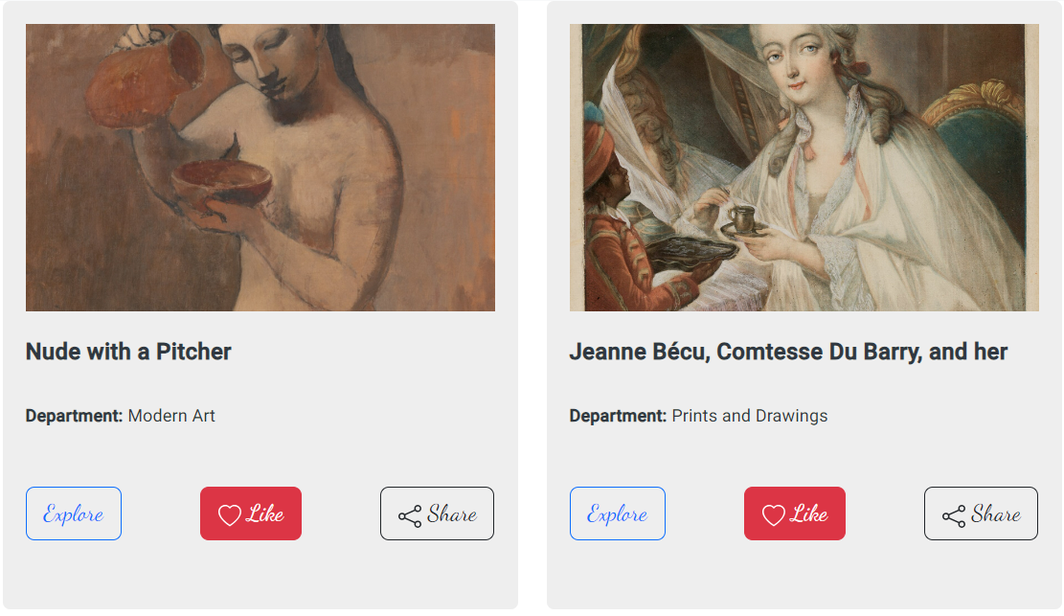
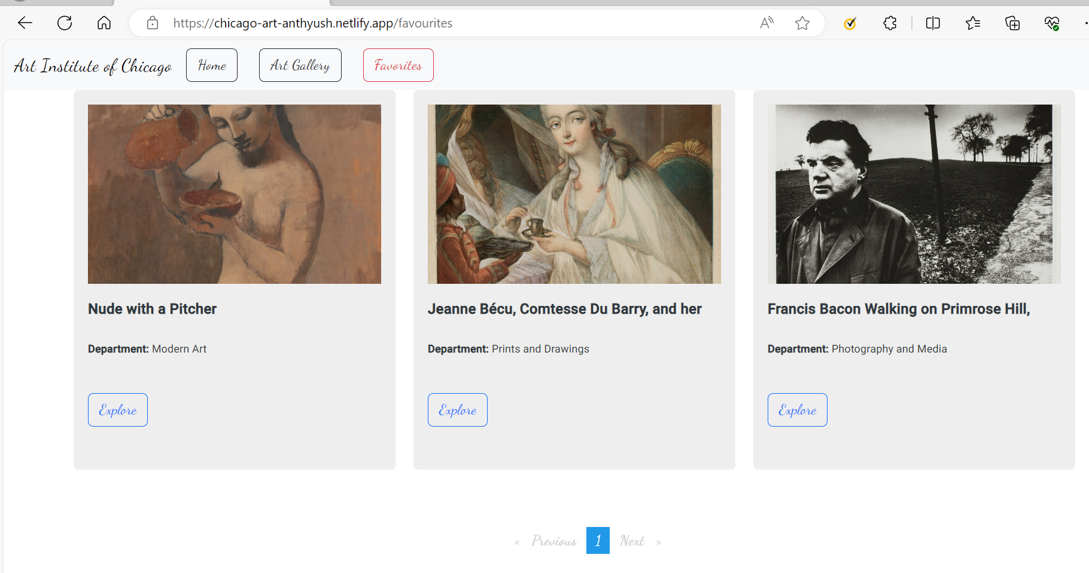
User Favorites:

Slide 9
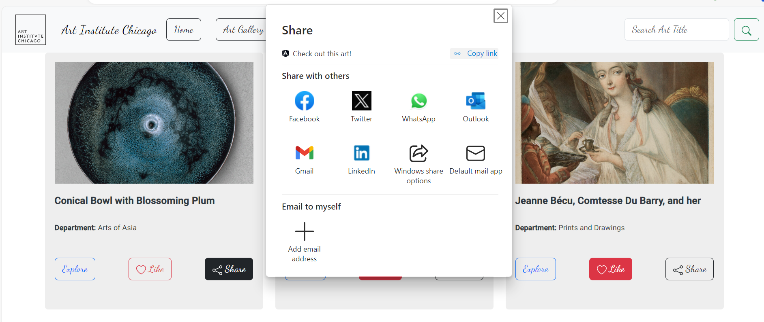
Share on Social Media:

Slide 10
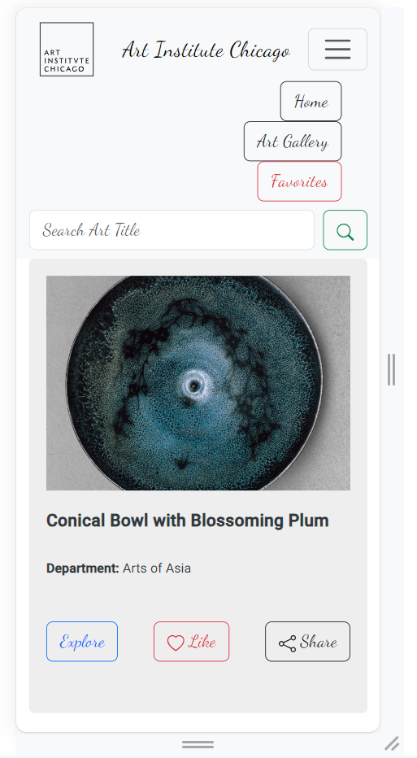
Responsive Design Mobile View:

Slide 11
Thank You

